Slide 1

ROBOT FRAMEWORK
Building Automation Testing Using Robot Framework

Slide 2
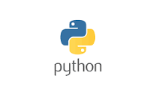



PRE-REQUISITES You need to complete these before
SeleniumLibrary

Slide 3
ROBOT FRAMEWORK
Introduction robot framework

Slide 4
Introduction Robot Framework
is a Python-based
extensible keyword-driven automation framework for acceptance testing
acceptance test driven development (ATDD),
behavior driven development (BDD)
robotic process automation (RPA)

Slide 5
Introduction Robot Framework
free to use without licensing costs
easy syntax, utilizing human-readable keywords
Its capabilities can be extended by libraries implemented with Python, Java or many other programming languages

Slide 6

Why Robot Framework
Enables easy-to-use tabular syntax for creating test cases in a uniform way.
Provides ability to create reusable higher-level keywords from the existing keywords.
Provides easy-to-read result reports and logs in HTML format.
Is platform and application independent.
Provides a simple library API for creating customized test libraries which can be implemented natively with Python.
Supports creating data-driven test cases.
Has built-in support for variables, practical particularly for testing in different environments.

Slide 7
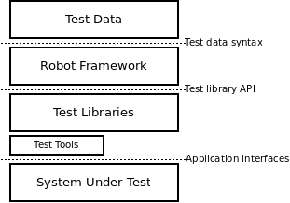
High-level architecture
Robot Framework is a generic, application and technology independent framework
It has a highly modular architecture illustrated in the diagram

Slide 8
Features of Robot Framework​
Keywords
Robot framework comes with built-in keywords available with robot framework, keywords available from the libraries like Selenium Library (open browser, close browser, maximize browser, etc.). We can also create user-defined keywords, which are a combination of other user-defined keywords or built-in or library keywords. We can also pass arguments to those keywords, which make the user-defined keywords like functions that can be reused.​
Variables​
Robot framework supports variables – scalar, list and dict. Variables in robot framework are easy to use and are of great help while writing complex test cases.​

Slide 9
Features of Robot Framework
•Libraries
Robot framework has support for a lot of external libraries like Selenium Library, Database Library, FTP Library and http library. Selenium Library is mostly used as it helps to interact with the browsers and helps with web application and UI testing. Robot framework also has its own built-in libraries for strings, date, numbers etc.
•Resources
Robot framework also allows the import of robot files with keywords externally to be used with test cases. Resources are very easy to use and are of great help when we need to use some keywords already written for other test projects.
•Data driven test cases
Robot framework supports keyword driven style test cases and data driven style. Data driven works with high-level keyword used as a template to the test suite and the test cases are used to share data with the high-level keyword defined in the template. It makes the work very easy for testing UI with different inputs.

Slide 10
Features of Robot Framework
•Test Case Tagging
Robot framework allows to tag test-cases so that we can either run the tags test-cases or skip the tagged testcases.
Tagging helps when we want to run only a group of test cases or skip them.
•Reports and Logs
Robot framework provides all the details of test suite, test case execution in the form of report and logs.
All the execution details of the test case are available in the log file. The details like whether the test case has
failed or passed, time taken for execution, steps followed to run the test case are provided.

Slide 11
Benefit robot framework
It is open-source framework.
It follows keyword driven, behaviour driven and data driven approach for writing test script.
Robot Framework has very easy syntax and uses human readable keywords.
It capabilities can be extended libraries implemented in Java and python.
Robot framework is extensively used for RPA, Database, API automation & Web automation.
This is the only framework which comes with all industry standard framework features with very minimal coding.

Slide 12
Limitation robot framework for automation testing
Robot framework does not support parallel execution
Hard to customize html report
Robot framework is hard to maintain
Some error are difficult to debug
Robot framework has strict indentation rules

Slide 13
Installing Robot Framework
Robot Framework is implemented with Python, so you need to have Python installed.
On Windows machines, make sure to add Python to PATH during installation.

Slide 14
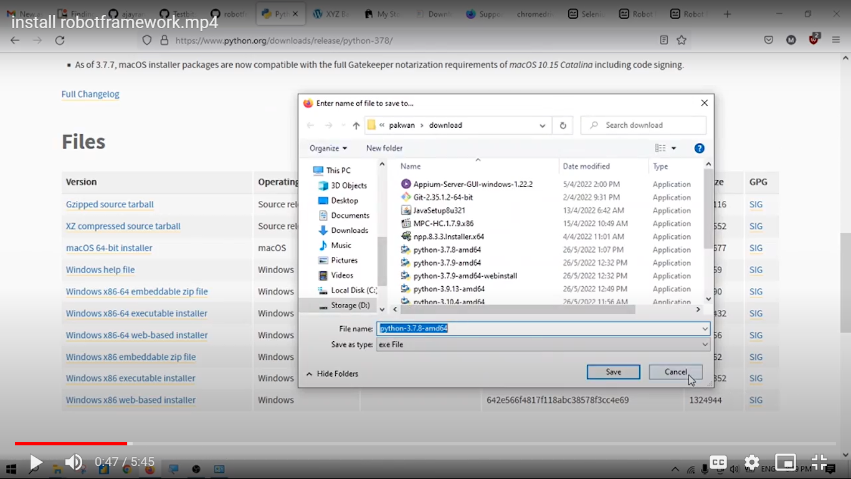
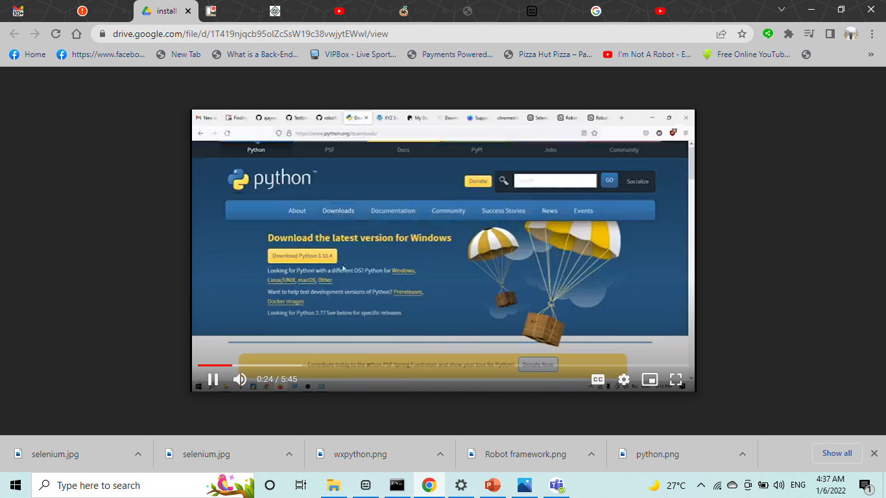
Install python

Slide 15
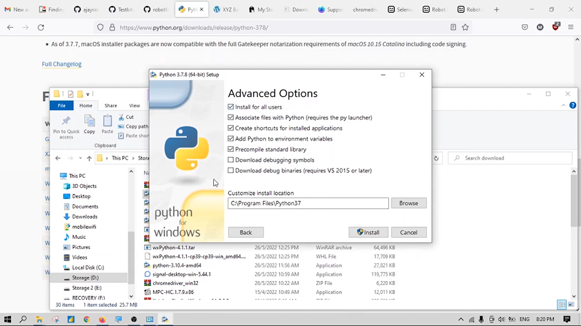
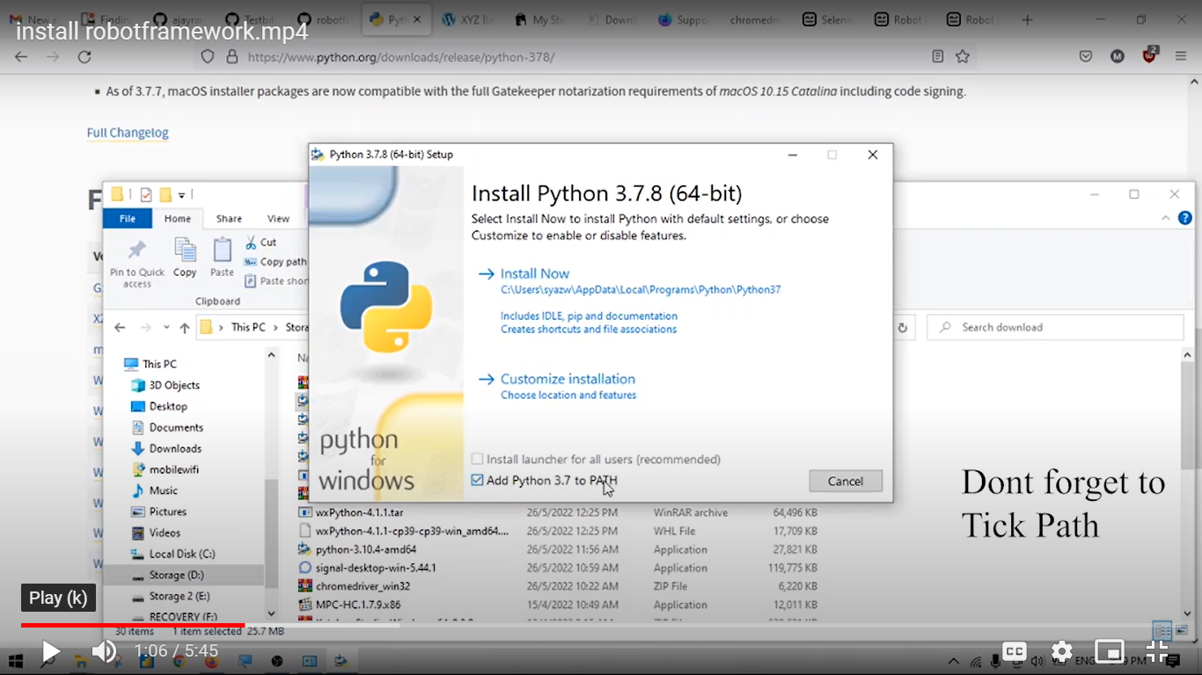
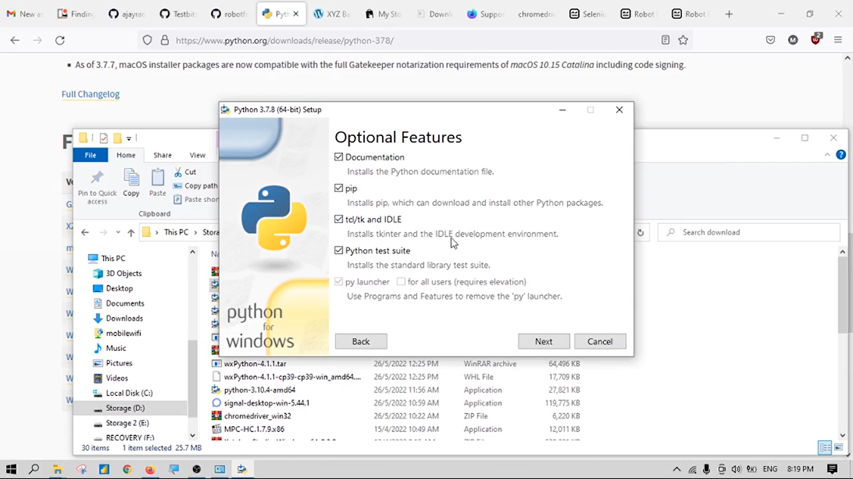
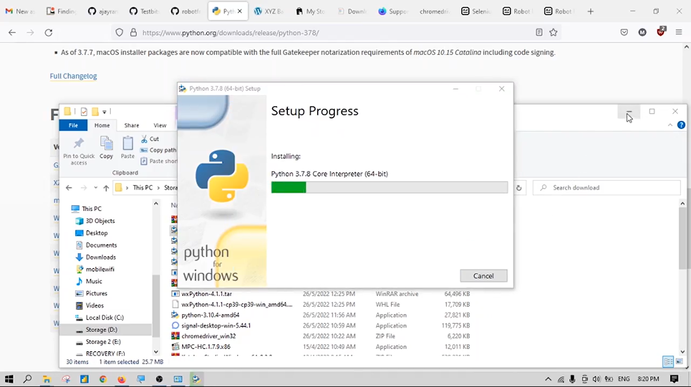

Slide 16
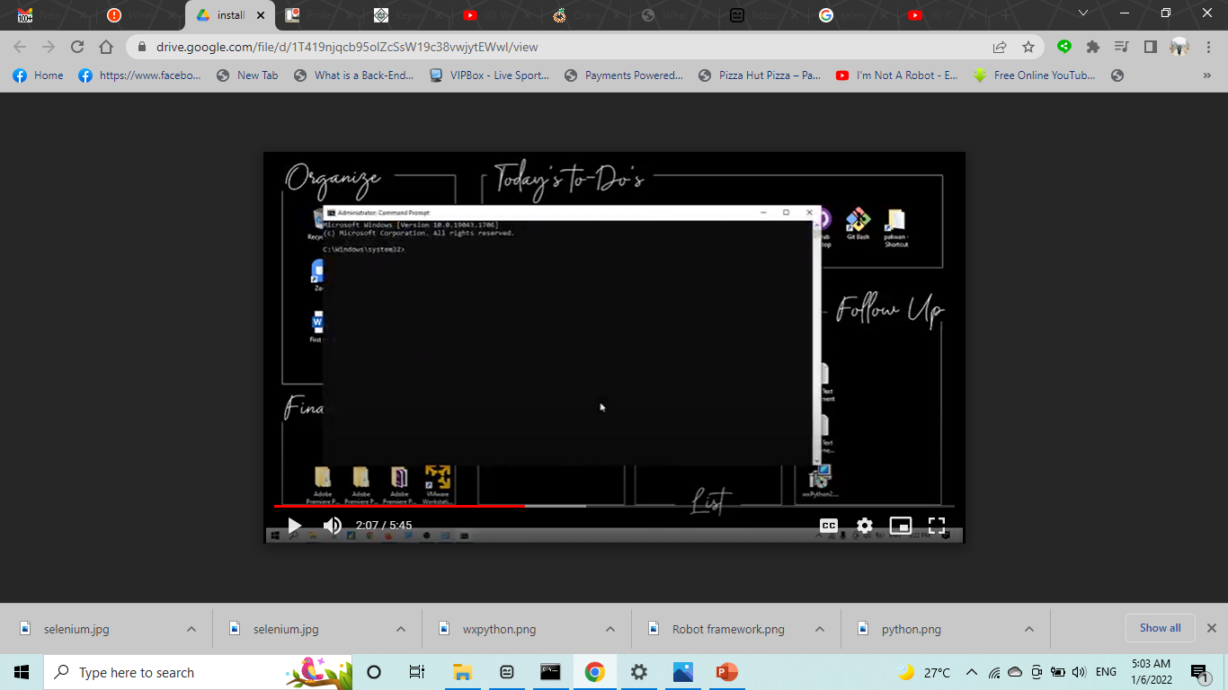
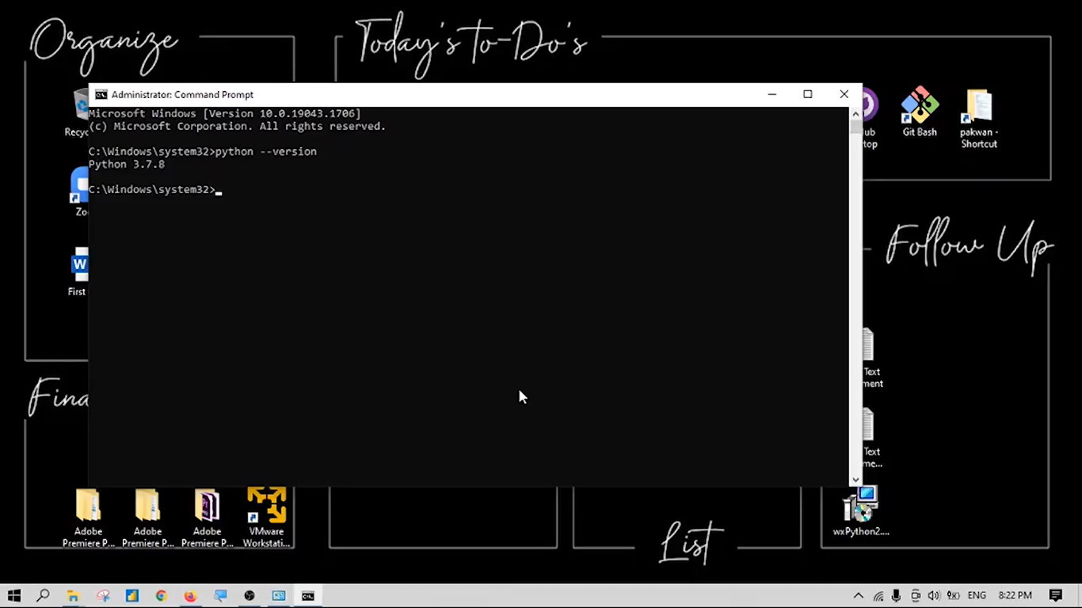
Check python use command prompt
Open cmd
Python --version

Slide 17
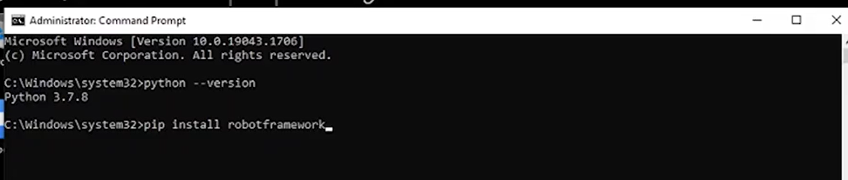
Install robot framework
Type pip install robotframework

Slide 18
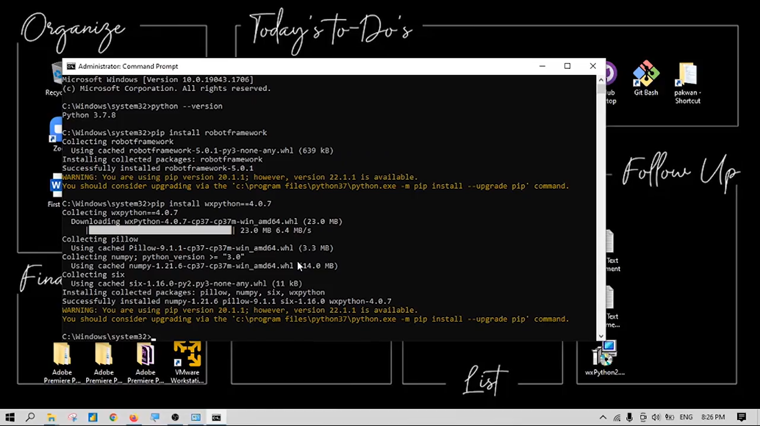

Slide 19
Install wxpython
Type pip install wxpython==4.0.7

Slide 20
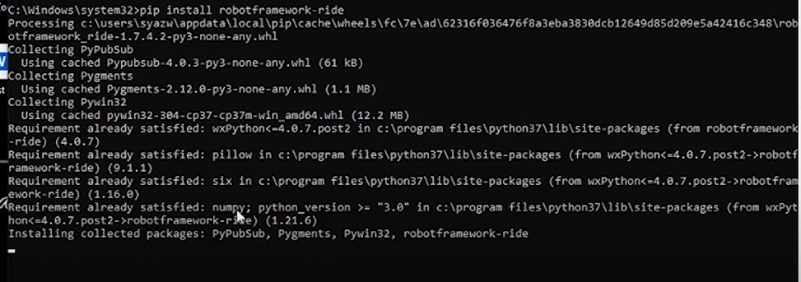
Install ride
Type pip install robotframework-ride

Slide 21
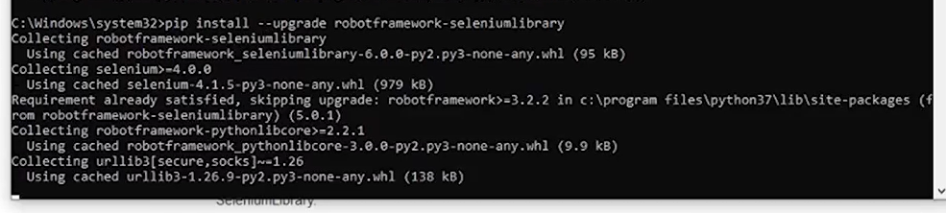
Install Selenium Library
Type pip install –upgrade robotframework-seleniumlibrary

Slide 22
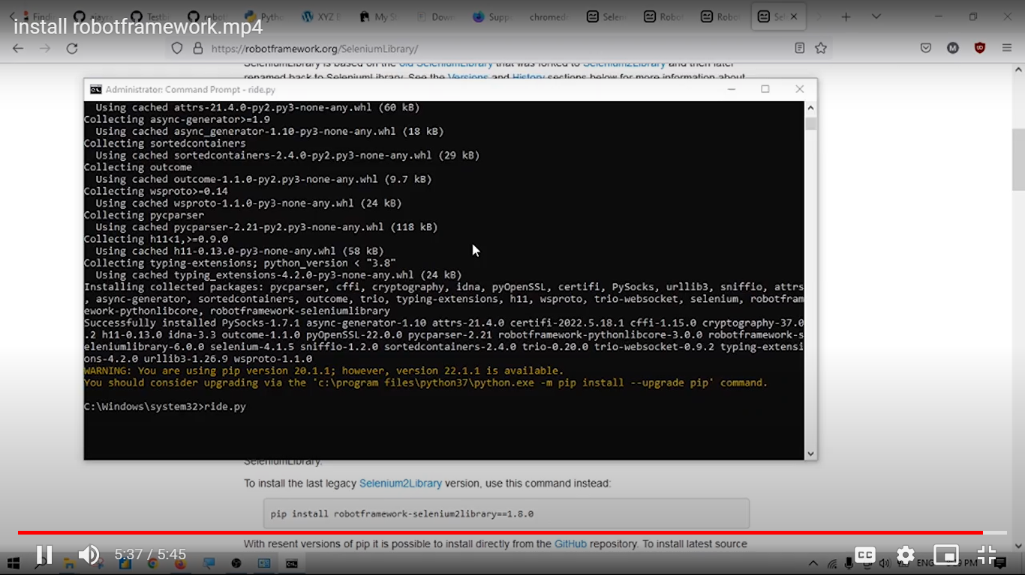
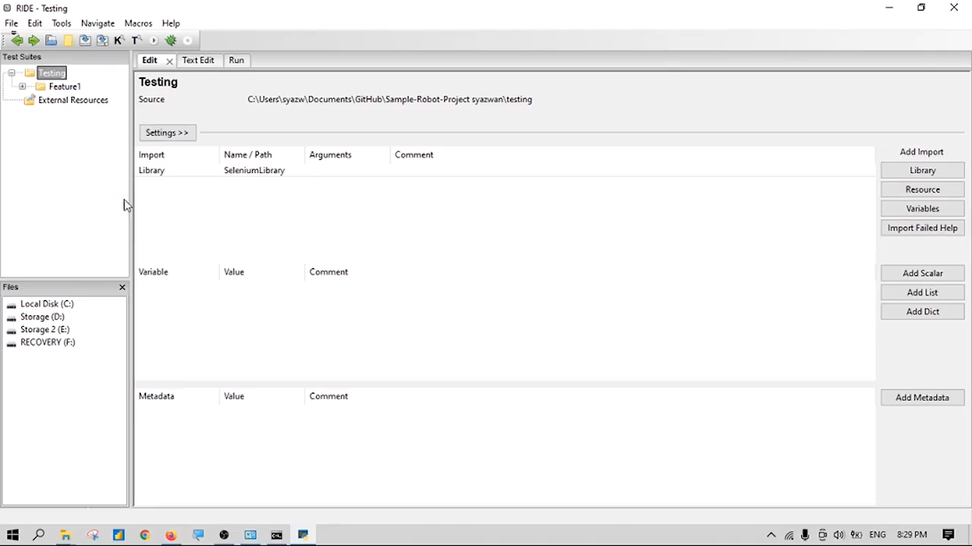
Open ride robot framework
Type ride.py

Slide 23
Test data syntax
Files and directories
Test cases are created in test case file.
A test case file automatically creates a test suite containing the test cases in that file.
A directory containing test case files forms a higher-level test suite. Such a test suite directory has suites created from test case files as its child test suites.
A test suite directory can also contain other test suite directories, and this hierarchical structure can be as deeply nested as needed.
Test suite directories can have a special initialization file configuring the created test suite.

Slide 24
Test data sections
Different sections in data
Section | Used for
Settings | 1) Importing test libraries resource files and variable files 2) Defining metadata for test suites and test cases
Variables | Defining variables that can be used elsewhere in the test data.
Test Cases | Creating test cases from available keywords.
Tasks | Creating tasks using available keywords. Single file can only contain either tests or tasks.
Keywords | Creating user keywords from existing lower-level keywords
Comments | Additional comments or data. Ignored by Robot Framework.

Slide 25
Keywords in Selenium Library

Slide 26
List of keywords that used in this project
Keywords | Deceptions
Open browser | Opens a given browser instance to the given url address
Close Browser | Closes browser window/tab
Click Element | Click the element identified by locator(element)
Input Text | Types the given text into the text field identified by locator
Select From List by Label | Selects options from selection list locator by given value
Choose File | Inputs the file_path into the file input field locator.
Element Text Should Be | Verifies that element locator contains exact the text expected

Slide 27
Sytax of Keywords in Table in Edit tab.
1st Column | 2nd column | 3rd column
Open browser | [link of website] | [webdriver] : chrome
Close Browser
Click Element | Path of element (xpath,html, etc)
Input Text | Path of element | Test data
Select From List by Label | Path of element | Value
Choose File | Path of element | Directory of test data file
Element Text Should Be | Path of element | text that should be
For Choose File, recommend to save test data file into folder that save test suite. Then on third column, type ' ${CURDIR}/file name '

Slide 28
If want to find more library keywords, can refer to:
https://robotframework.org/SeleniumLibrary/SeleniumLibrary.html#library-documentation-top

Slide 29
Copy Element (Xpath) in webpage

Slide 30
Steps:
i. Choose element that want to get code
ii. Right click and then click on Inspect
iii. Inspect coding tab is shown on right (or left/below) and it will highlight code that represent

Slide 31
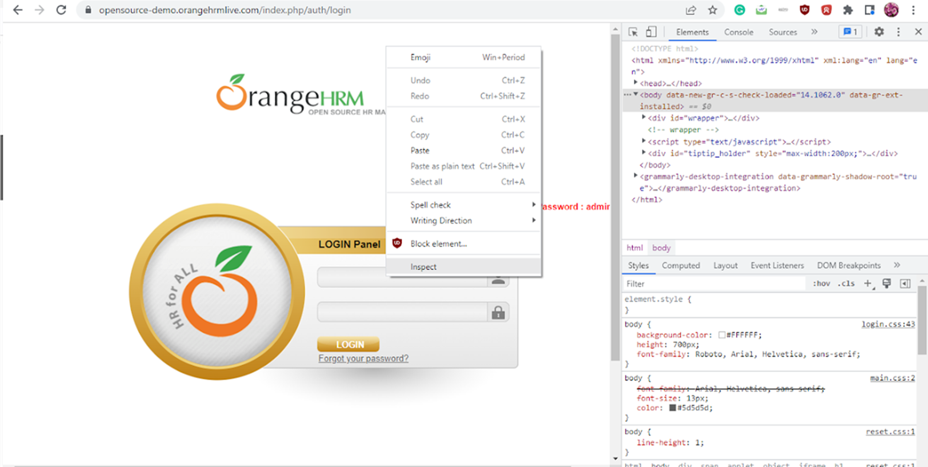

Slide 32
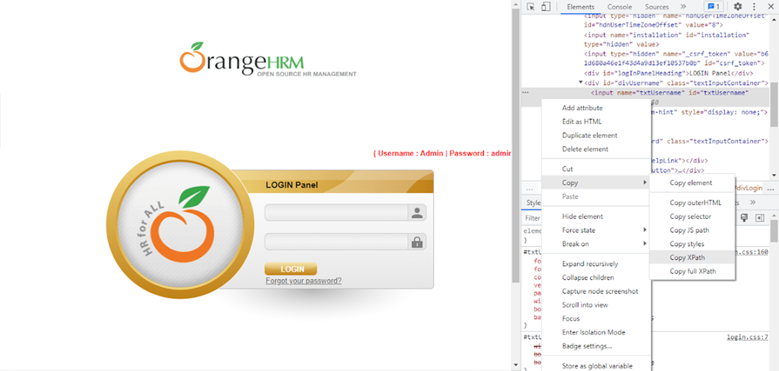
iv. Right click on the highlight code and click Copy -> Copy XPath

Slide 33
Open Directory Project in RIDE
Open RIDE
Click ‘File’ on top left. Then choose Open Directory.
Then choose project folder that consist testing script
For this tutorial choose ‘Robotframework Testing from documentation’ folder inside ‘Robotframework_ProjectAssignment_Group2’ GitHub repository.

Slide 34
First testing
Success Adding Candidate

Slide 35
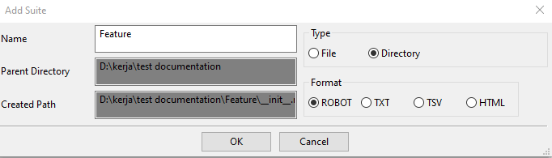
Step 1: Create Directory/folder
Create new directory/folder (optional) for saving step definitions: Right click on main directory (on left side of RIDE) and choose ‘New Suite’.
In Add Suite window, change Type from ‘File’ into ‘Directory’. Then click ‘OK’. ‘Feature’ directory can be found under main directory

Slide 36
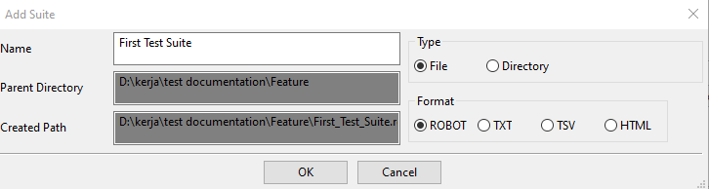
Step 2: Create Test Suite
Right click on Feature Directory and choose ‘New Suite’.
In Add Suite window, named it as ‘First Test Suite’ and then click OK. This test suite can be found under Feature.

Slide 37
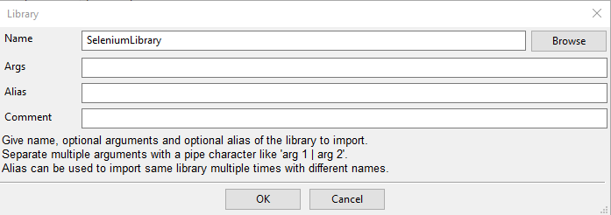
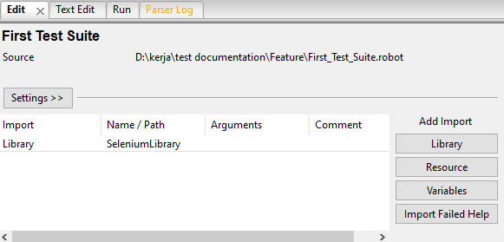
Step 3: Import Selenium Library
Click on library under 'import' and import Selenium Library by typing: 'SeleniumLibrary'. Then click OK.
On Edit Section (2nd picture), if colour of SeleniumLibrary is black, it means this library is valid. If colour is red, it means this library is invalid

Slide 38
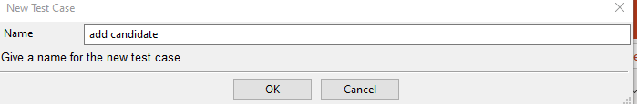
Step 4: Create Test Case
Right click on main directory (on left side of RIDE) and choose ‘New Test Case’.
In Add Suite window, named it as ‘add candidate’ and then click OK. This testcase can be found under Test Suite.

Slide 39
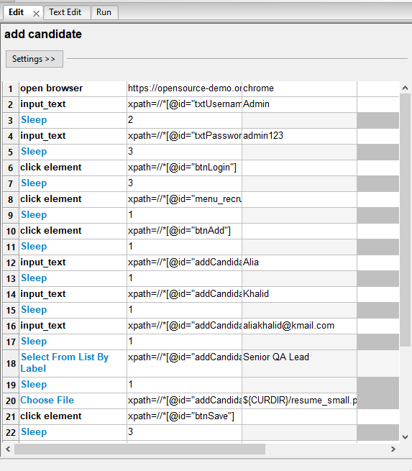
Step 5: Put test steps into Test Case
Click on test case and click Edit tab.
In First column, put library keywords based on steps that have planned for this testing
Copy element (Xpath) of object inside webpage. Then put elemets into second column
Put value (only for steps that involve test data) into third column

Slide 40
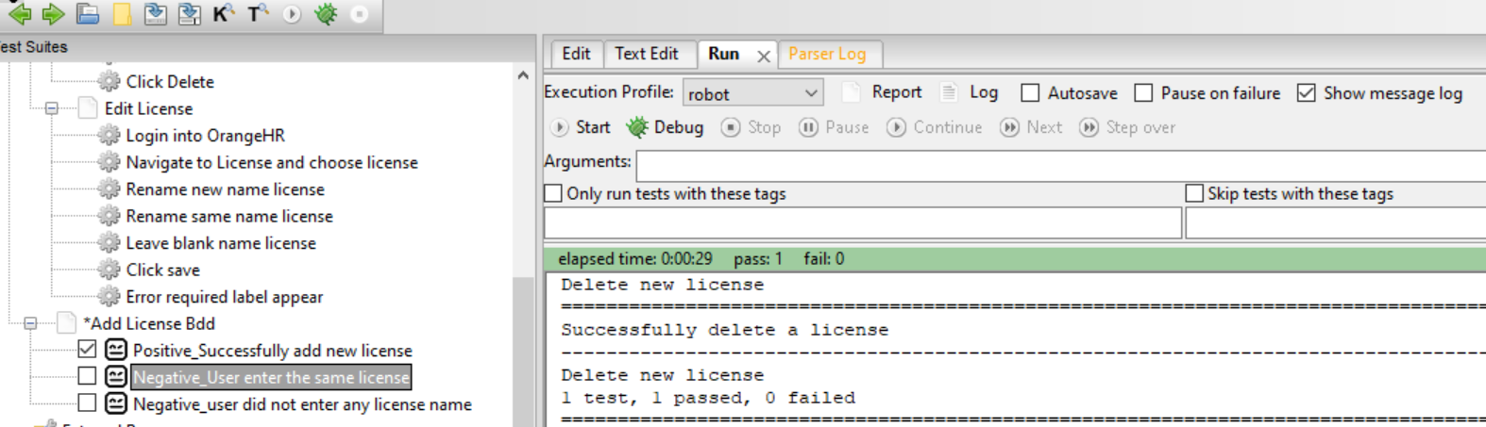
STEP 6: Run test case
Tick the test case you want to run.
Go to ‘Run’ tab
Click ‘Start’ robot button.

Slide 41
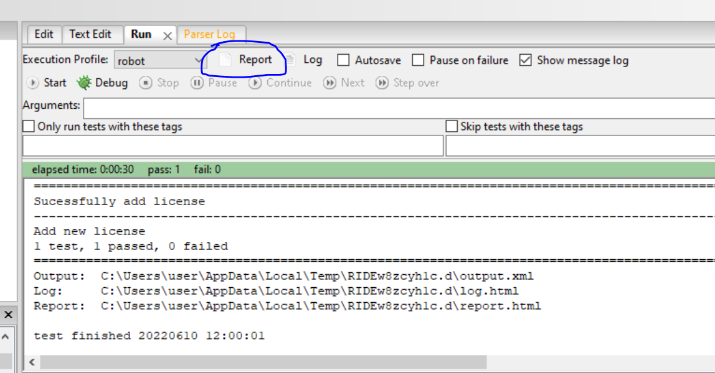
STEP 7: Test case report
Click report button on ‘Run’ tab to check the report.

Slide 42
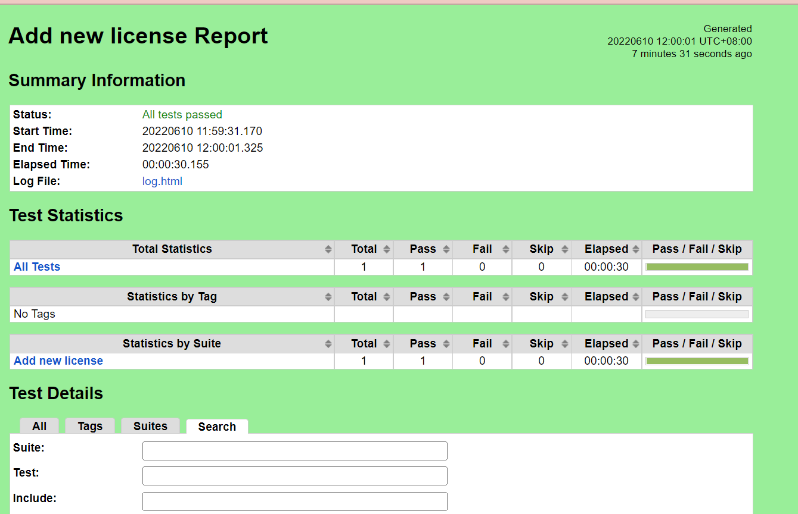
Example of test case report

Slide 43
To make testing process become proper, advance and easily, there are several features/setting that we will learn:
Test Setup
Test Teardown
Variable
Keywords File
Resource File

Slide 44
Test Setup and Teardown

Slide 45
Test Setup and Test Teardown
Test Setup: keyword/step that is executed before a test case(s)
Test Teardown: Keyword/step that is executed after a test case (s)
Both can be set in Test Suite.
Steps
Go to test suite in Edit tab
Click Setting
Find Setup and Teardown and click 'Edit'
Put keyword/step

Slide 46
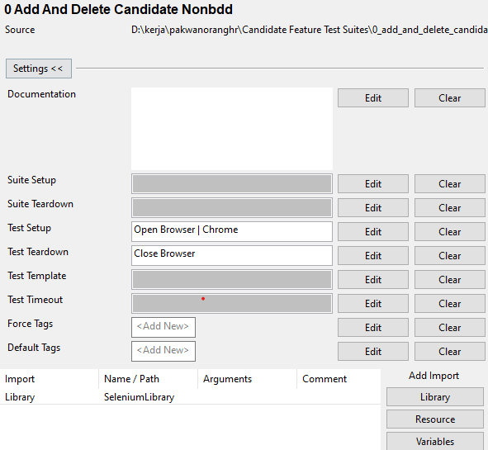
But only one keyword/step can be set for both.
To have keywords/steps in setup and teardown, keywords file should be created and set to both

Slide 47
Variable, Keywords File and Resource File

Slide 48
Variable
Variables are an integral feature that can store test data.
Variables can be used in arguments for keywords in Test Case and Keyword sections, but also all settings allow variables in their values
Very important for data driven
Variables is not only store test data, it also can store page object path (html,xpath,etc)

Slide 49
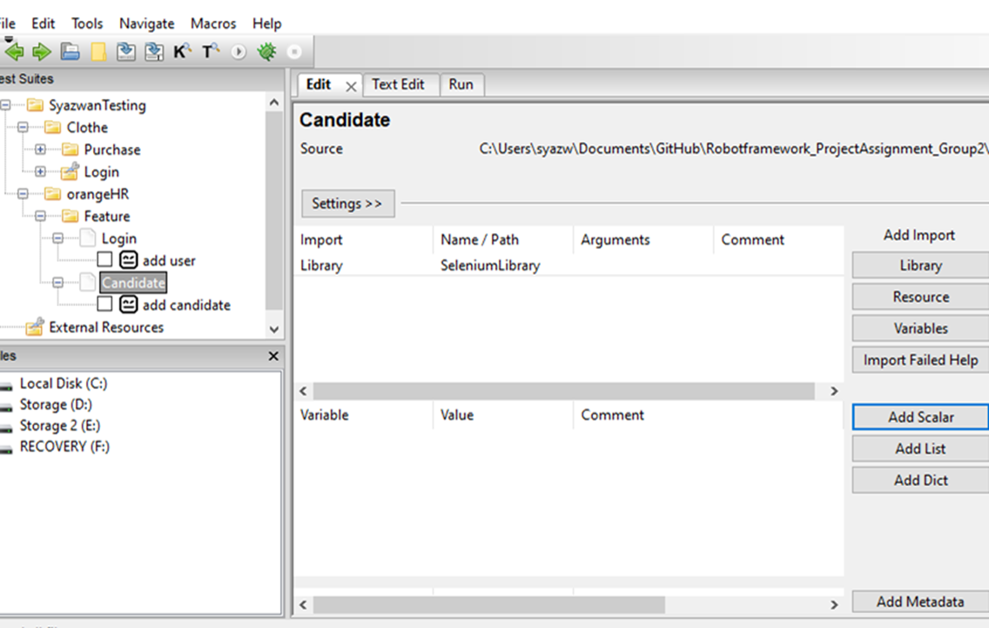
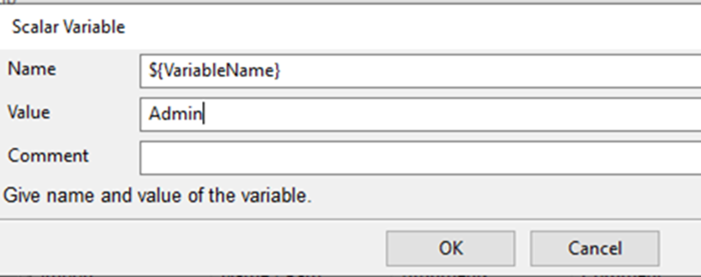
Steps (using edit tab)
i. Navigate to Test Suit
ii. Click on ‘Add Scalar’ on right bottom (1st picture)
iii. Add Scalar window is popup, write variable name inside {} and put value that you want (2nd picture)

Slide 50
iv. Now go to test case
v. To add variable, write ${Variablename} on third column as shown below:
*If colour of Variable is green, it means this variable is existing. But if its colour is light purple/pink, it means this variable is not existing.

Slide 51
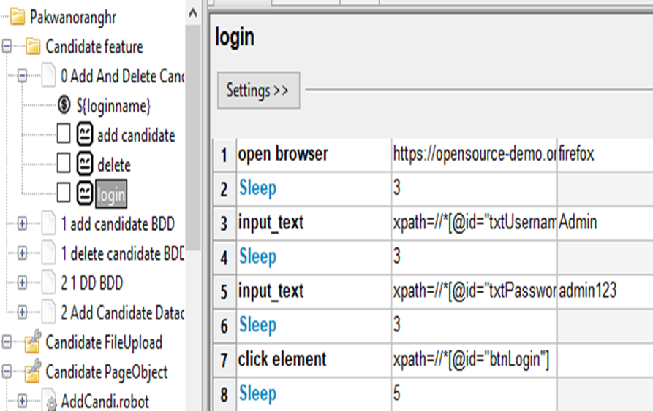
Keywords File
Combining existing keywords/test steps together
Steps:
Select any test case inside test suite. Inside test case, there are many keywords/test steps.
Main objective for this is creating keywords file so it can be set on Test Setup.
Select on test suite and then right click-> New User Keywords to create keywords file

Slide 52
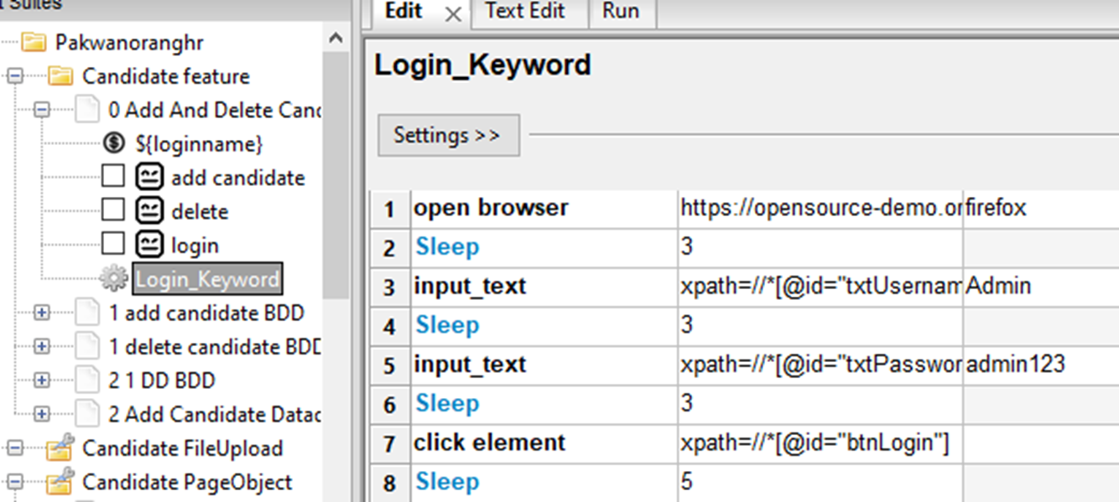
iv. Inside keywords file, copy/write keywords/test steps

Slide 53
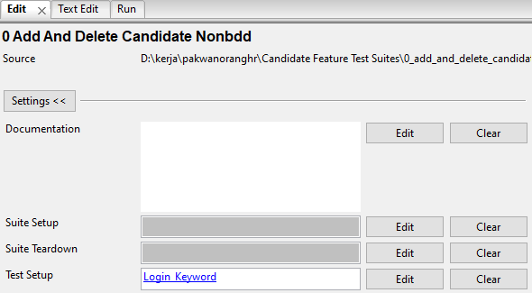
v. After that, go to login test cases and delete (if you want).
vi. Go to Test Suite -> Setting. And then put keywords file name on Test Setup
vii. This test case can be run

Slide 54
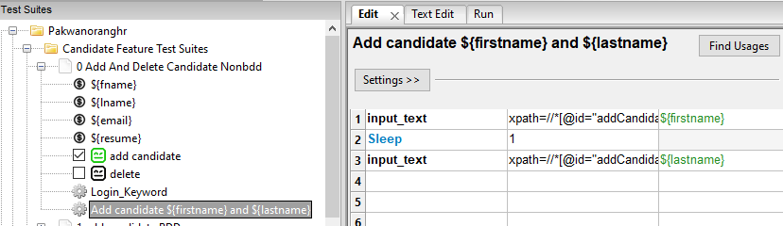
There is Keywords file that can link with variables.
i. Create keywords file and name it with any name include the variable
Example: Add candidate ${firstname} ${lastname}
ii. Put keywords/steps that related to those variable. After that, put variable names on third column and row that related

Slide 55
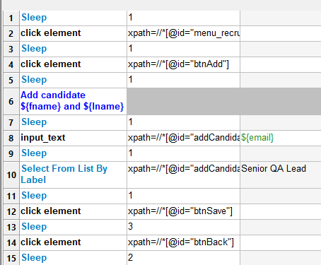
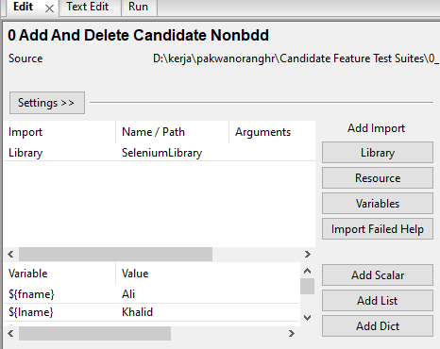
iii. Go to test case Add Candidate, replace those two input steps with:
Add candidate ${fname} ${lname}
Refer 1st picture
Note: Make sure name of variables are same with variable in test suite, not with keywords file name (refer 2nd pivture)
iv. Test case can be run.

Slide 56
For more detail by looking test suite that used setup, teardown, variable and keyword file, can refer to '1 Adding Candidate More Setting' test suite

Slide 57
Resource File
Keywords and variables from test suite A cannot be used on another test suits
Resource files provide a mechanism (keywords and variable) for sharing them

Slide 58
Steps:
Create scenarios resource by right click on main folder (or other folder/directory) and click ‘New Resource’.
‘New resource file’ window will be popped up. Give a name and click ‘OK’.
Click on that scenarios resource file
You can create variables or keywords inside resource file.

Slide 59
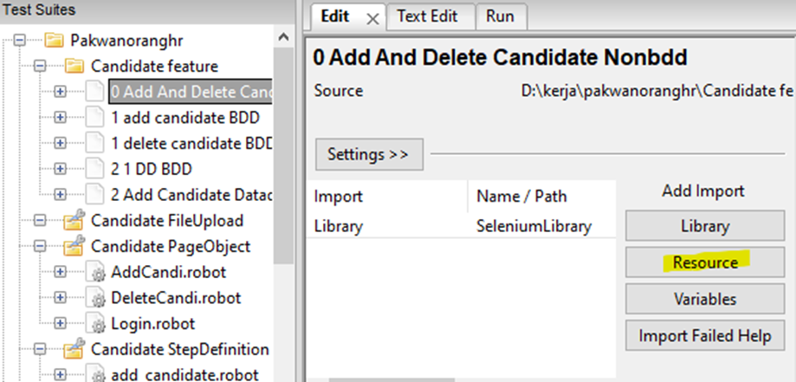
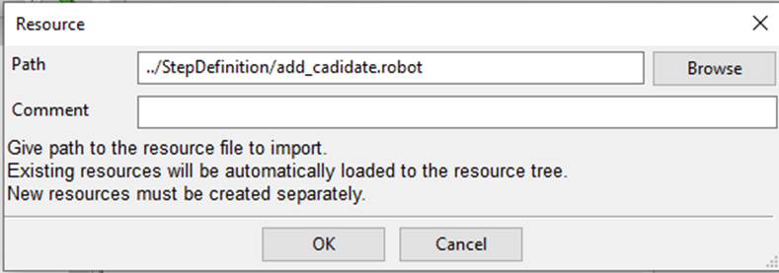
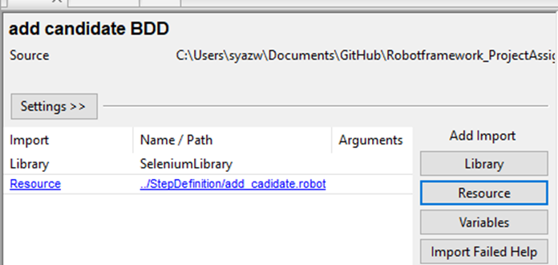
v. Go to any test suite. Then, click ‘Resource’ under Add Import
vi. Resource’ window will be popped up. Browse scenario resource file as shown in below and click OK.
vii. The list of added library and resource is shown. If library and resource are invalid, colour of library and resource word become red.

Slide 60

Behavior-driven development

Slide 61
Behavior-driven development
BDD is method when an application is documented and designed around the behavior a user expects to experience when interacting with it.
BDD helps to avoid bloat, excessive code, unnecessary features or lack of focus from developer and others.

Slide 62
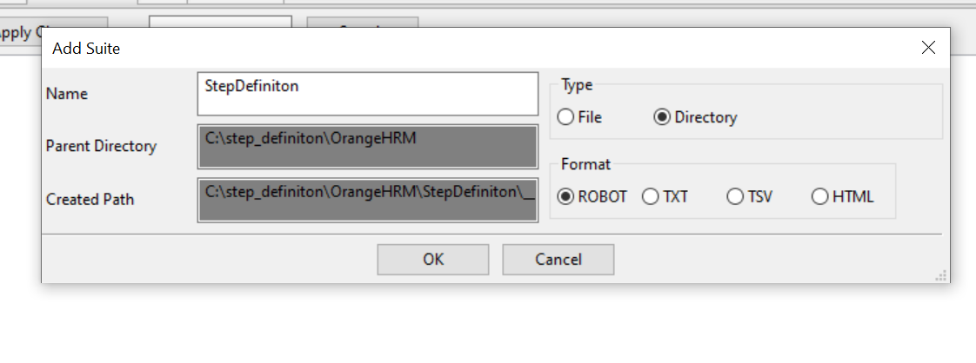
STEP 1 : Create StepDefinition directory folder
Create new project
Right-click on the project and choose new suite. Select the type as ‘Directory’ and format ‘ROBOT’.
Name the file as ‘StepDefinition’ then click OK.

Slide 63
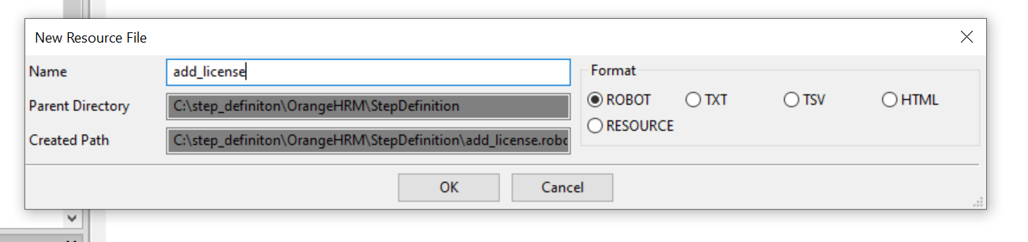
STEP 2: Create Step Definition directory folder
Right-click on the StepDefiniton file and choose new resource. Name the file. Eg: Add_license.robot
Choose format ‘ROBOT’. Then click ‘OK’

Slide 64
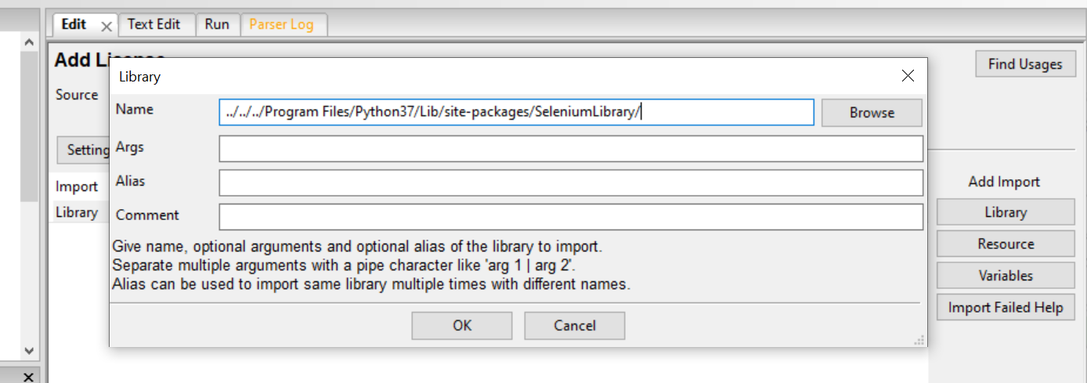
STEP 3: Import library & resources
Click on the ‘add_license.robot’ resources file
Click edit. Then click on ‘Library’ on the right-side.
Browse and choose your Selenium library folder.
Click ‘OK’
Click ‘Resources’ to add other resources file

Slide 65
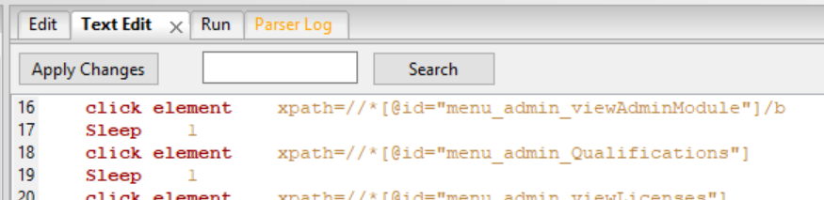
STEP 4 :Create user keyword
There is two ways two create user-keyword
Tab ‘Edit’
Tab ‘Text Edit’

Slide 66
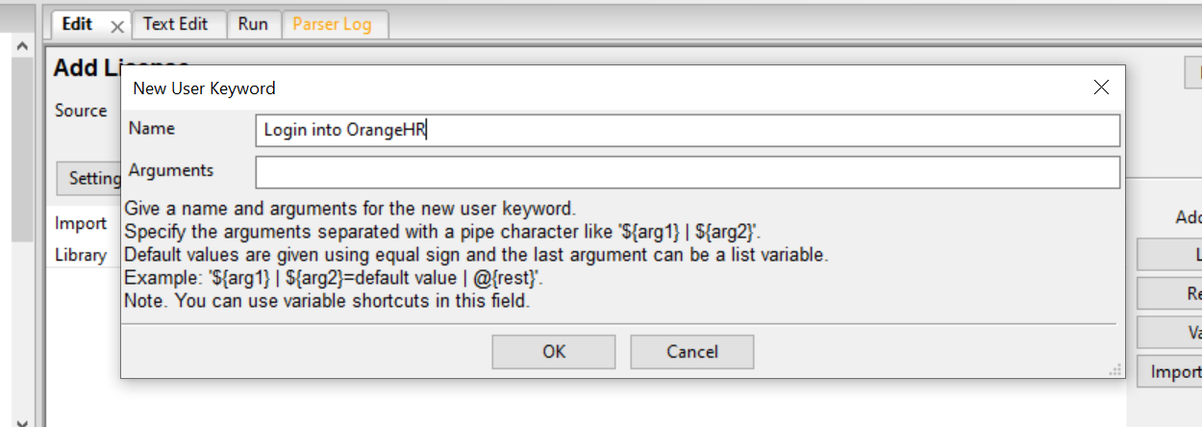
STEP 4.1: Create user keyword (Tab ‘edit’)
Right-click on resource file eg: add_license.robot
Select new user keyword
Enter new user keyword and click ‘OK’

Slide 67
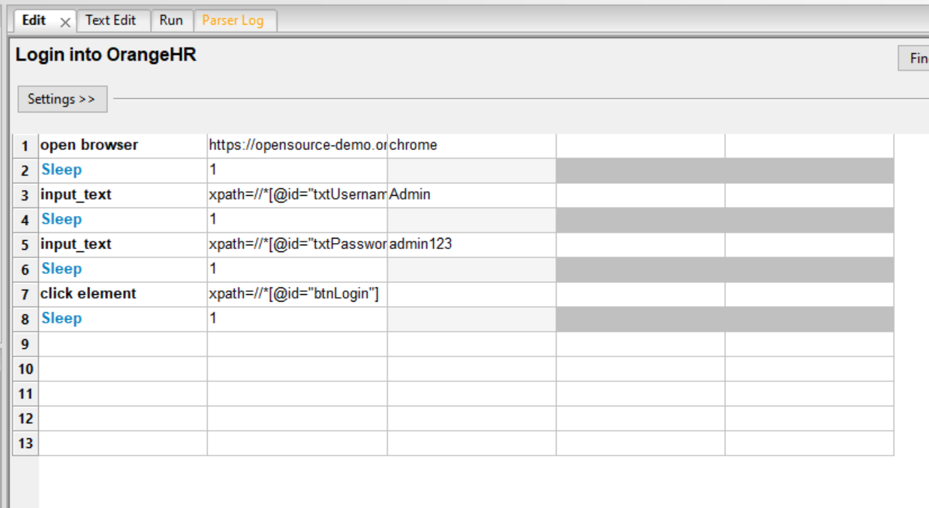
Write steps, xpath and value into scenario file as shown in below:
Then, save the file.

Slide 68
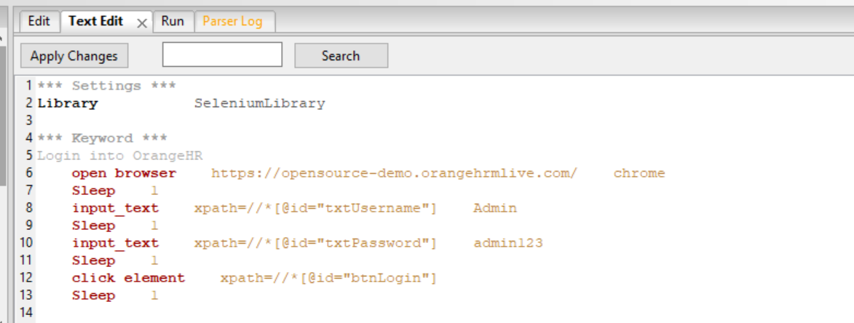
STEP 4.2 : Create user keyword (Tab ‘Text edit’)
Directly click on ‘Text Edit’ Tab
Write steps, xpath and value into scenario file as shown in below:
Then save the file

Slide 69
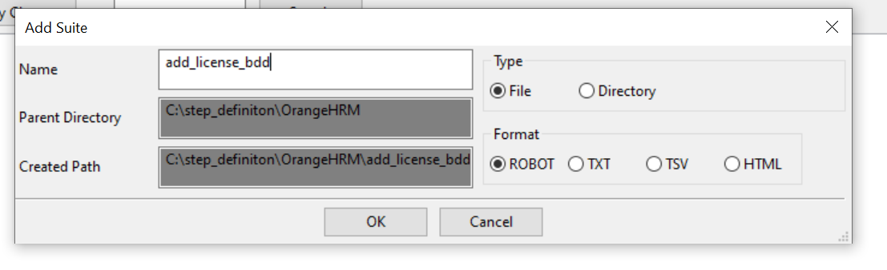
STEP 5 : Create new suite for BDD
Right-click on feature folder and choose new suite
Name the BDD file eg: add_license_bdd
Choose type ‘File’ and format ‘ROBOT’ then click ‘OK’

Slide 70
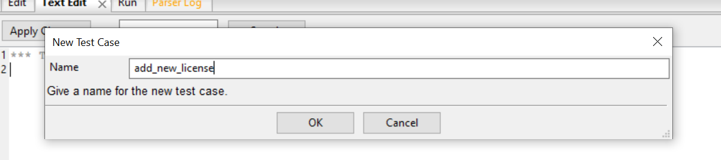
STEP 6 : Create new test case
Right-click on BDD test suite file and choose new test case.
Name the tase case. Eg: add_new_license
Click ‘OK’

Slide 71
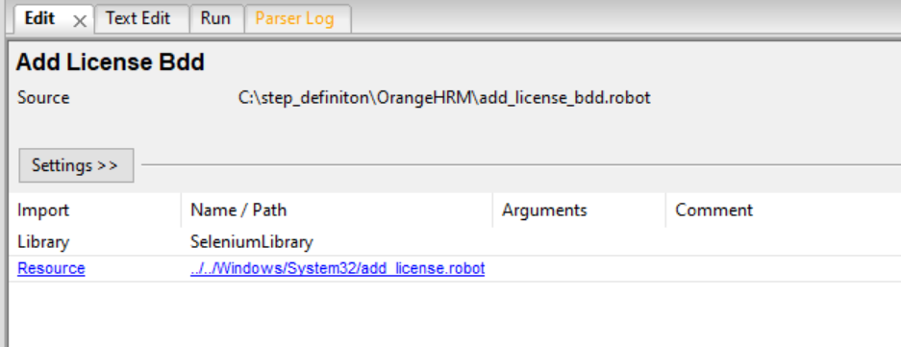
STEP 7 : Import library and resources
Click on library and import Selenium Library
Click on resources and import your resources file
Then, click ‘OK’

Slide 72
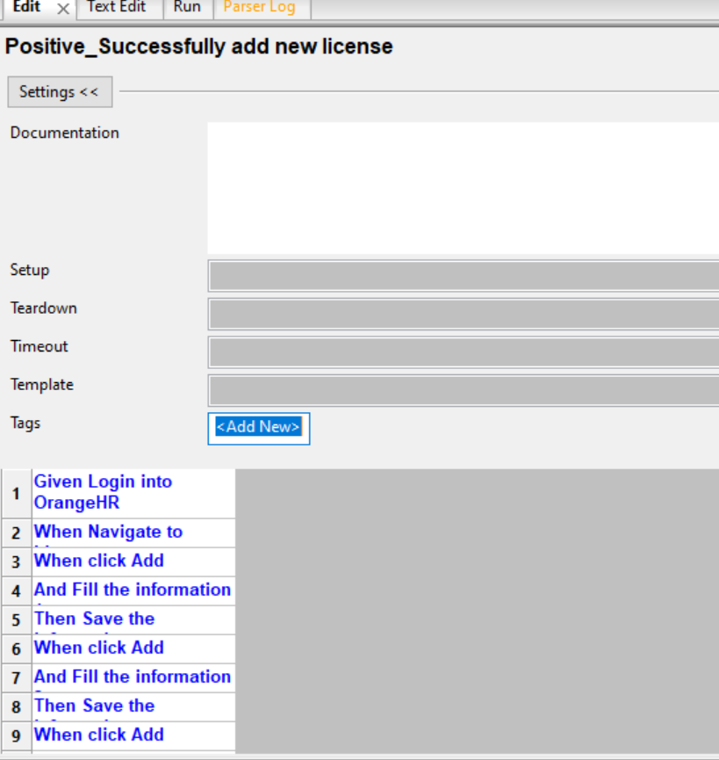
STEP 8 : Write scenarios
You can write and edit your scenarios through ‘Edit’ tab
If the colour turn out ‘blue’ means the scenarios written are valid from your resources file.

Slide 73

STEP 9 : Write scenarios
You can also write and edit your scenarios through ‘Text Edit’ tab

Slide 74
STEP 10: Run test case
Tick the test case you want to run.
Go to ‘Run’ tab
Click ‘Start’ robot button.
STEP 11: Test case report
Click report button on ‘Run’ tab to check the report.

Slide 75

Data Driven (DD)
*Learn creating keywords and variable first

Slide 76


Steps:
Create test suite for data driven testing (e.g: named as Data Driven)
Create test cases that represent data. For this example, create three test cases
Click on test case and click Edit tab. Inside test cases, put data value for testing. For example, each test cases have three data value such as first name, last name and email. Then, put data value to another test cases

Slide 77


4. On Data Driven test suite, create Keywords (exp: named as DD add candidate)
5. Click on Data Driven test suite and then click on Text Edit tab.
6. Under **Setting**, type Test Template DD add candidate (name for keyword)

Slide 78

7. Under ‘DD add candidate’, type [Arguments] name of variables that will be used as following:

Slide 79


8. Then, type steps (either on Edit or Test Edit tab) in ‘DD add candidate’ keywords. For value, put name of variables on third columns for some steps as shown below:

Slide 80

9. Tick test cases.
10. Go to Run tab, and then click Start . It runs ticked test cases.

Slide 81
Data Driven + BDD
*Learn creating keywords and variable first

Slide 82

Steps:
Take Success Add Candidate BDD for example
1. Create new Test Suite which import StepDefinition resources file.
2. Create test cases that represent data (refer to 4 fill information).
3. Create Keywords and put argument and BDD step (from previous BDD test case)
4. Set ‘Test Template’ with name of keywords

Slide 83

5. We want step 'I fill information' be used for data driven. So, recall create keywords file will variable and create keywords file and name it as:
'I fill information ${firstname}, ${lastname} and ${email}‘
6. Inside Keywords file, change value (in third column and row that involve only) into name of variable

Slide 84

7. Go back to Test Suite. Change 'I fill information' into
'I fill information ${dd_fname}, ${dd_lname} and ${dd_email}'
*Note: name of variables must be same with argument variable
8. Go to Run tab, and then click Start . It runs ticked test cases.

Slide 85
Reference
https://robotframework.org/robotframework/latest/RobotFrameworkUserGuide.html
https://www.tutorialspoint.com/robot_framework/index.htm
https://youtu.be/ErTN5rE6t8s
https://youtube.com/playlist?list=PLhW3qG5bs-L9l2I8K8dEhw6HXy-Z-33w3

